Slide 1

TITLE
Presented by

Slide 2

Workshop Overview
Intended Audience: (ie. Beginner Data Scientists)
Goals:

Slide 3
Workshop Outline
Placeholder
Placeholder
Placeholder
Placeholder
Placeholder
Placeholder

Slide 4
Motivation
Slide content

Slide 5
What is NumPy?
Numpy (Numerical Python) is a library that provides fast, efficient multidimensional array objects & a collection of routines/operations for processing of said arrays.
Notably, large, multidimensional numpy arrays are much more efficient than regular python arrays.
Numpy offers a single basic data structure: an N-dimensional array type called ndarray : collection of items of the same type. Other numpy data structures : np.matrix (ndarrays are better!)
Notes:
Every item in an ndarray takes the same block size in memory, & arrays are stored contiguously : no gaps in memory storage; making them easily copyable and efficient to operate on.

Slide 6
NumPy : NDARRAY Object
There are a couple of essential ndarray fields:
dtype: strict type of the object in ndarray & may be:
predefined numpy type : float64, int32, complex128 etc
Native python types : bool, str, int etc
Custom user defined types : classes etc.
ndim: # of dimensions of the ndarray (>= 1).
shape: returns a tuple consisting of array dimensions. & can be used to resize the array. Order is important!

Slide 7
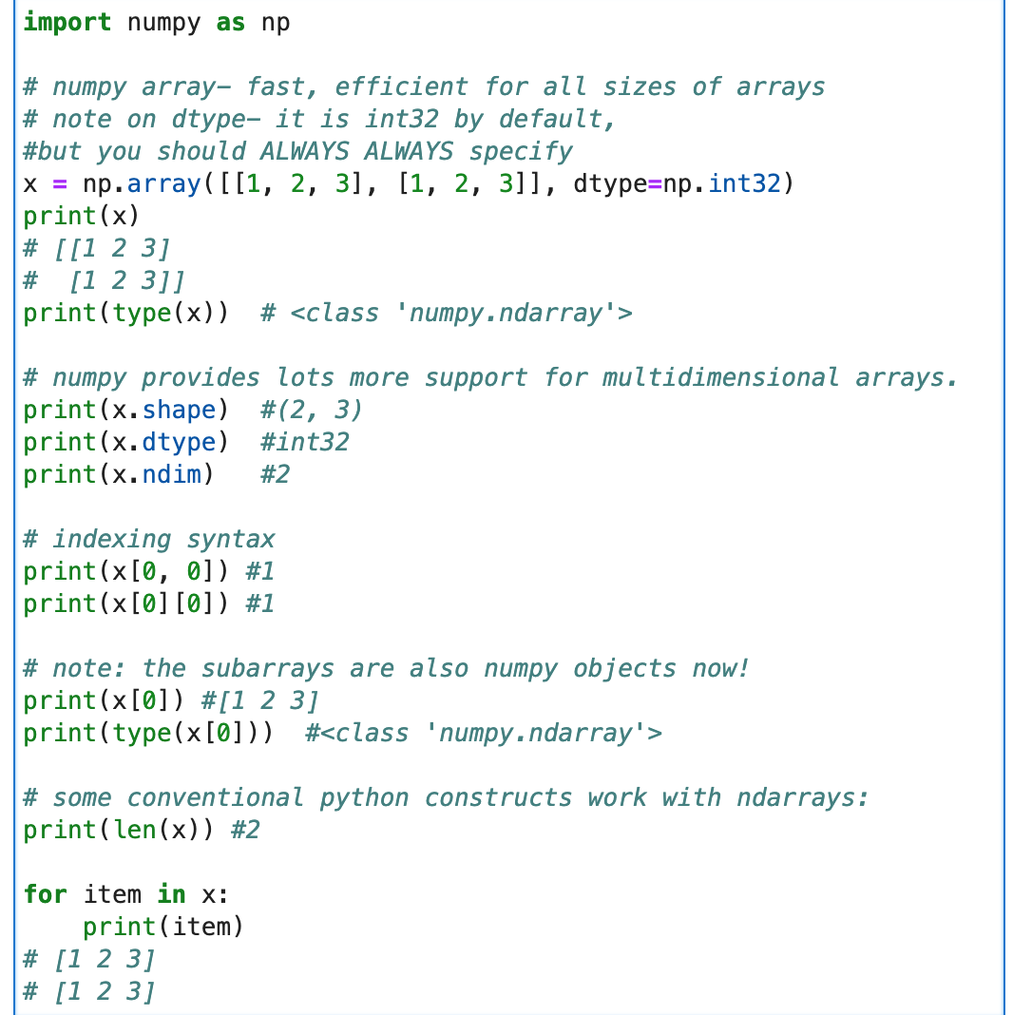
Example :

Slide 8
NumPy : Array Attributes
Reshape operation : changes the size of the array but the new shape could rearrange elements in potentially unintended ways, so be careful!
Rem: the product of the new dimensions must be exactly the total number of array items (total number of non-array objects)
Special case : reshaping with -1
Assumed to be an unknown dimension that numpy infers.
only exception to the rule above : the outputted dimensions do follow this rule however!

Slide 9
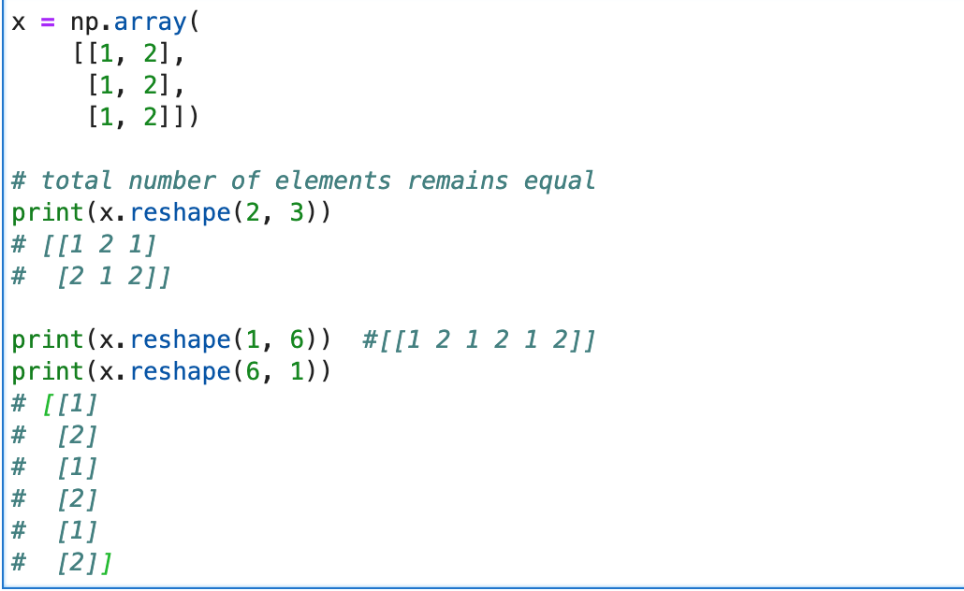
Reshape

Slide 10
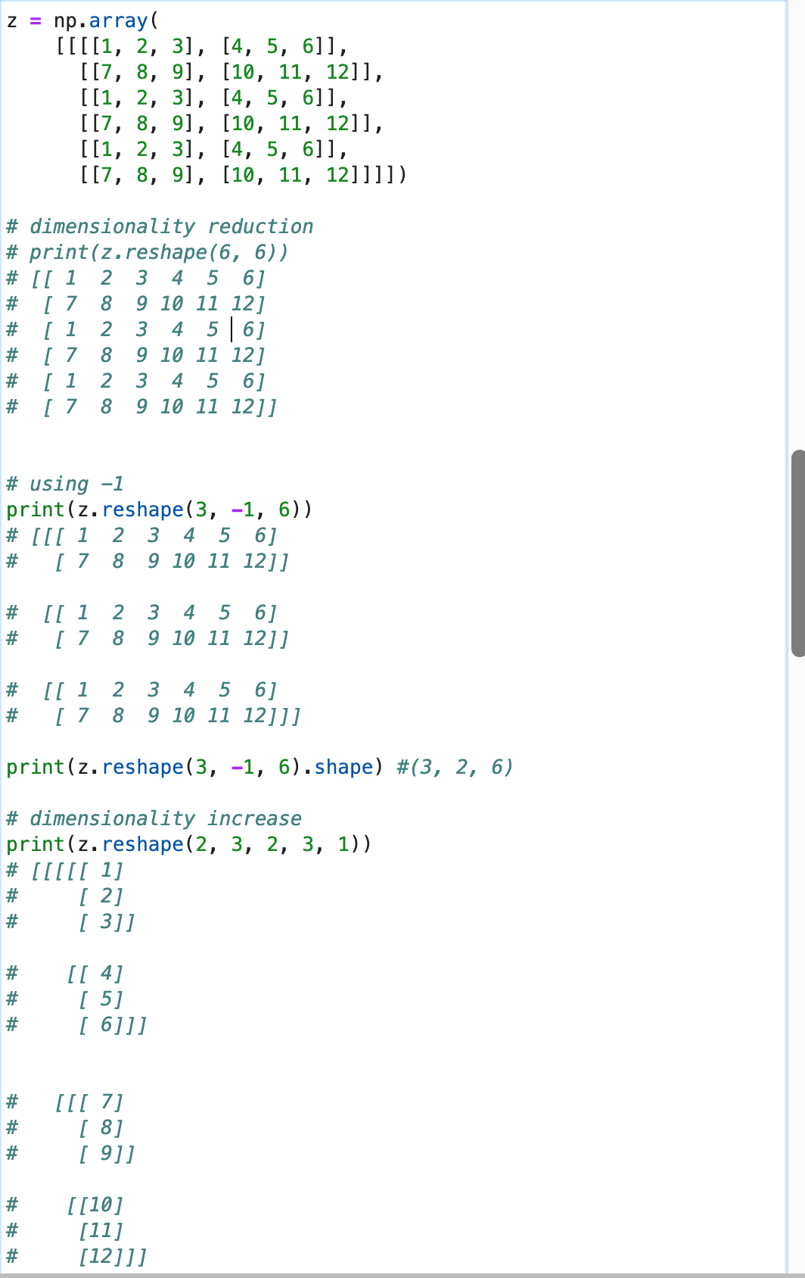
print
print
Reshape

Slide 11
NumPy : Operations
Numpy provides various array operations :
filter (via condition in the [ ] operator)
order
sum
max
mask (via a conditional expression)
transpose
sort (note: happens in-place)
any
all
concat (not a np.ndarray property)
default vector operations ( +, -, *, \)

Slide 12
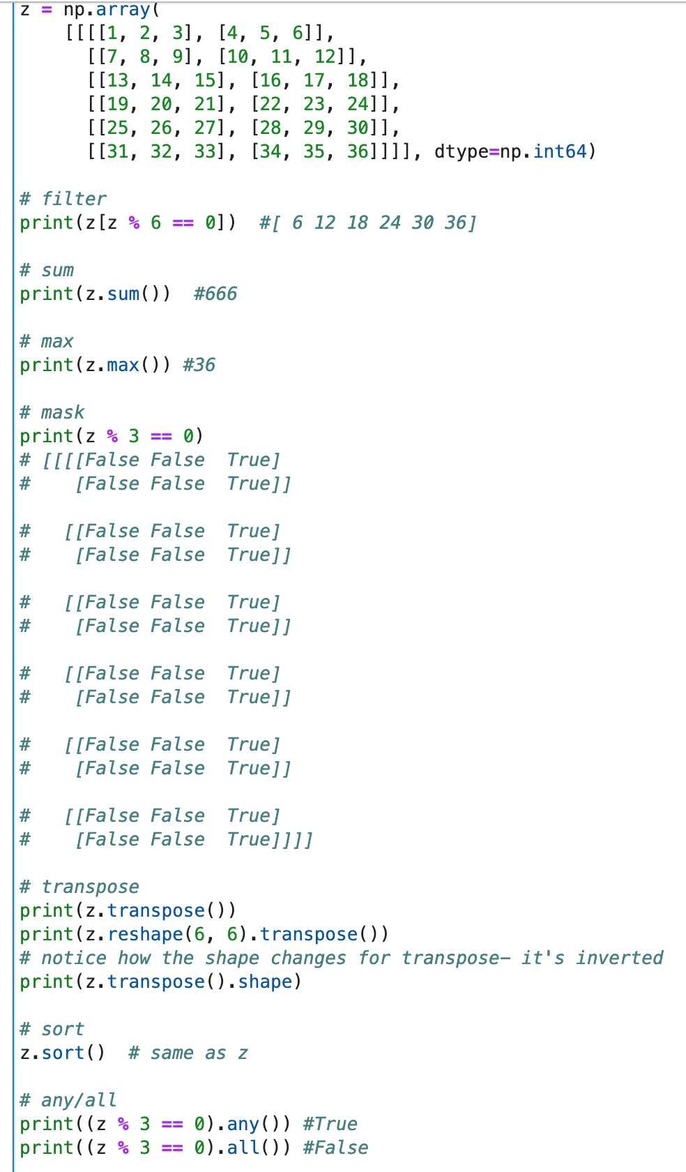
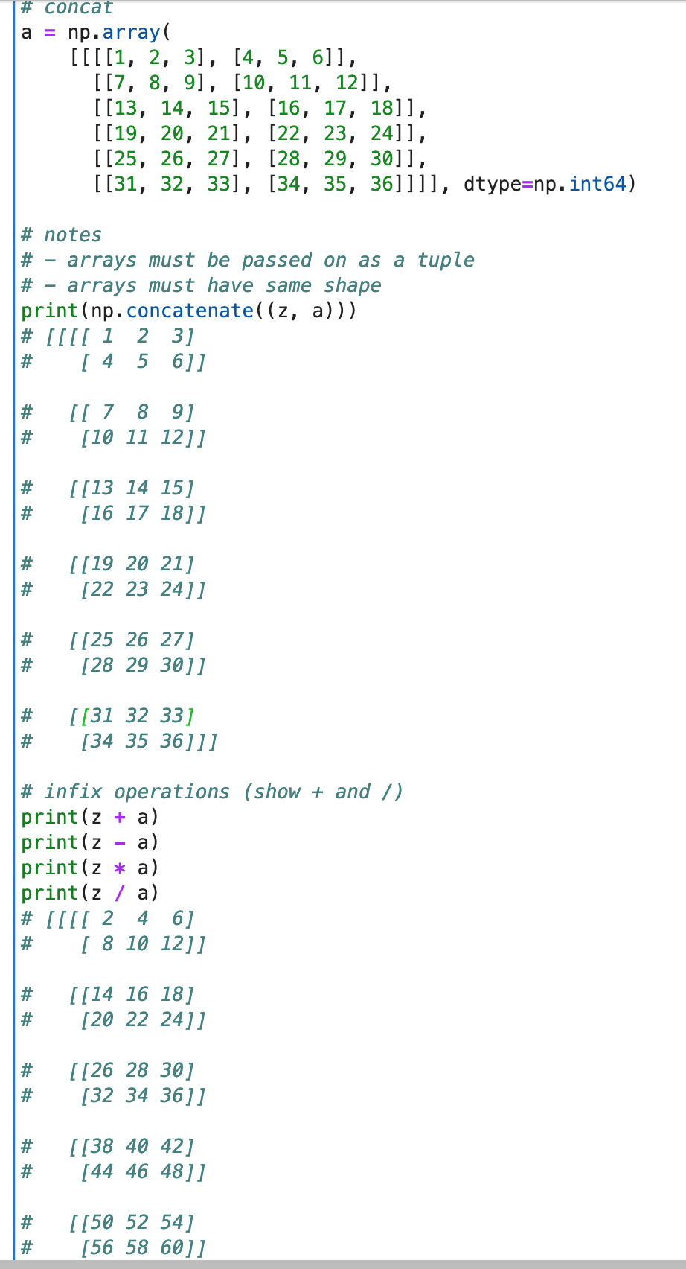
print
print
Operations

Slide 13
NumPy : Array Axes
Arrays can also be configured via their axis properties. Numpy operations can be applied on certain axes/ all axes, using the axis default parameter.
Recall shape : z.shape = (1, 6, 2, 3). Here, we see the array has 4 dimensions. In Numpy, these dimensions are 0-indexed.

Slide 14
NumPy : Ops and Axes
Numpy operations can be applied to some or all axes. This may cause the operation to flatten or alter the shape of the array to facilitate the operation.
Additionally, you may end up with an array in response to an operation that you may expect to provide you with a number.
Some operations may broadcast the operation across all axes, giving a return array with a completely new shape. This includes adding arrays with +. This only applies in certain situation though - in other you may get an error.

Slide 15
NumPy : Ops and Axes
The rule for computing the new shape is as follows:
if we have 2 arrays a and b, where a has shape (a1, a2, ..., an) and b has shape (b1, b2, ..., bn), and the result of a [ ] b is c with (c1, c2, ..., cn):
for each i in 1 to n:
if ai == bi, then ci = ai = bi.
if ai == 1 != bi then ci = bi.
if bi == 1 != ai then ci = ai.
if ai != 1 != bi then error.

Slide 16
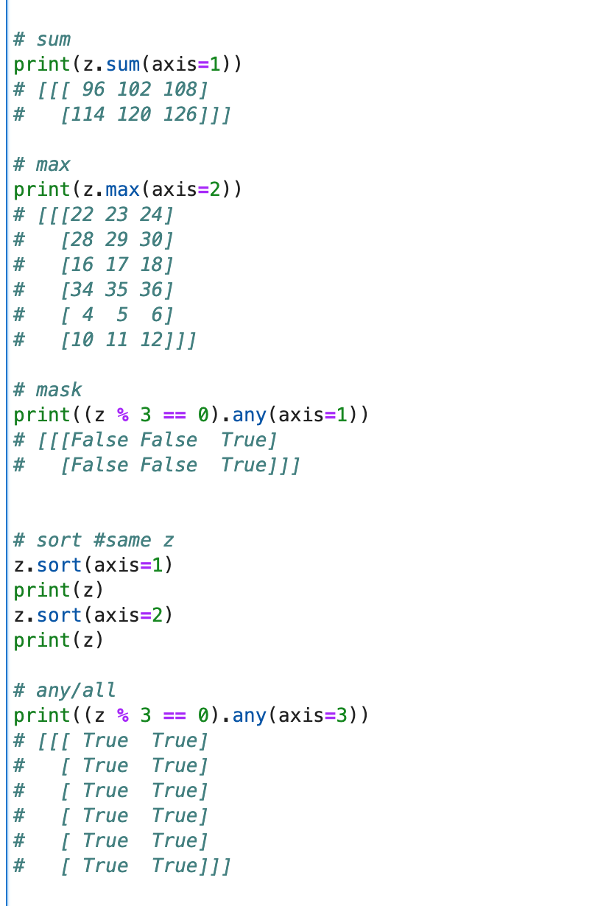
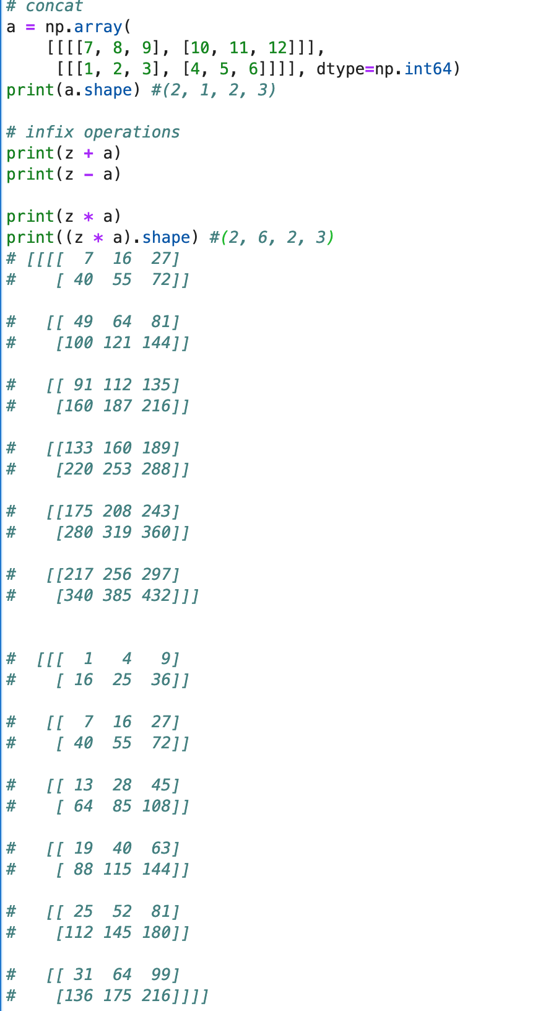
print
print
Operations & Axes

Slide 17
NumPy : Generative functions
Numpy also offers some operations for generation of arrays:
linspace
arange
rng
These arrays can be reshaped as desired to become useful, and manipulated exactly the same as regular arrays.

Slide 18
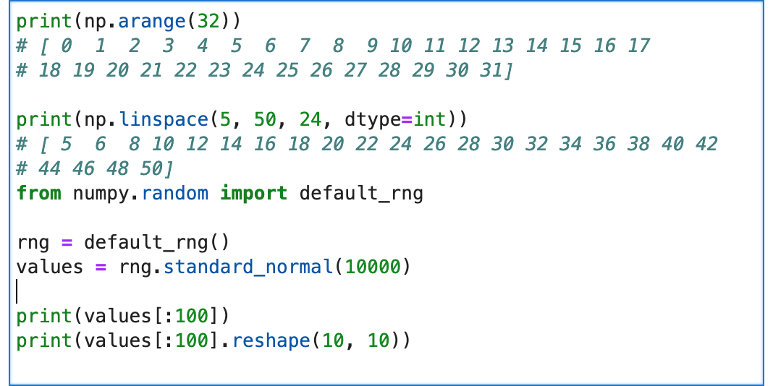
print
print
Generative Functions

Slide 19
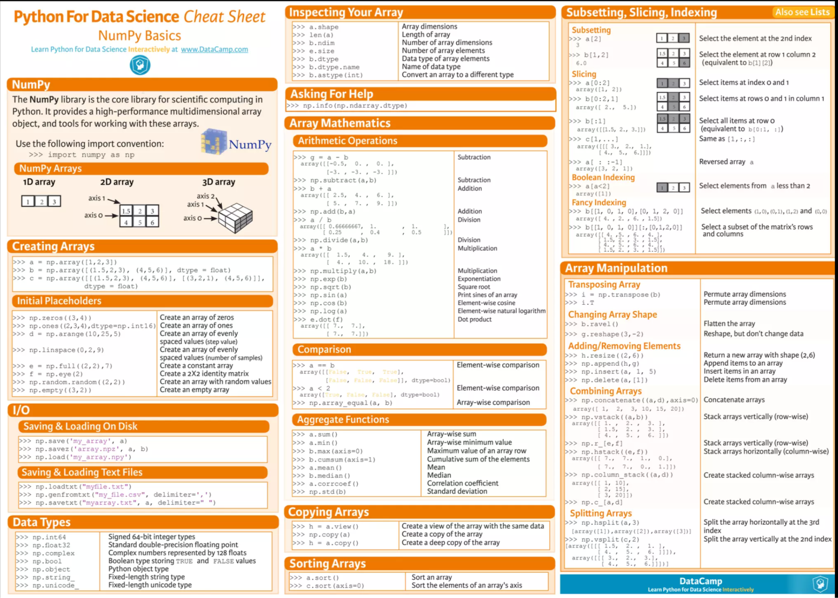
print
print
NumPy Cheat Sheet

Slide 20
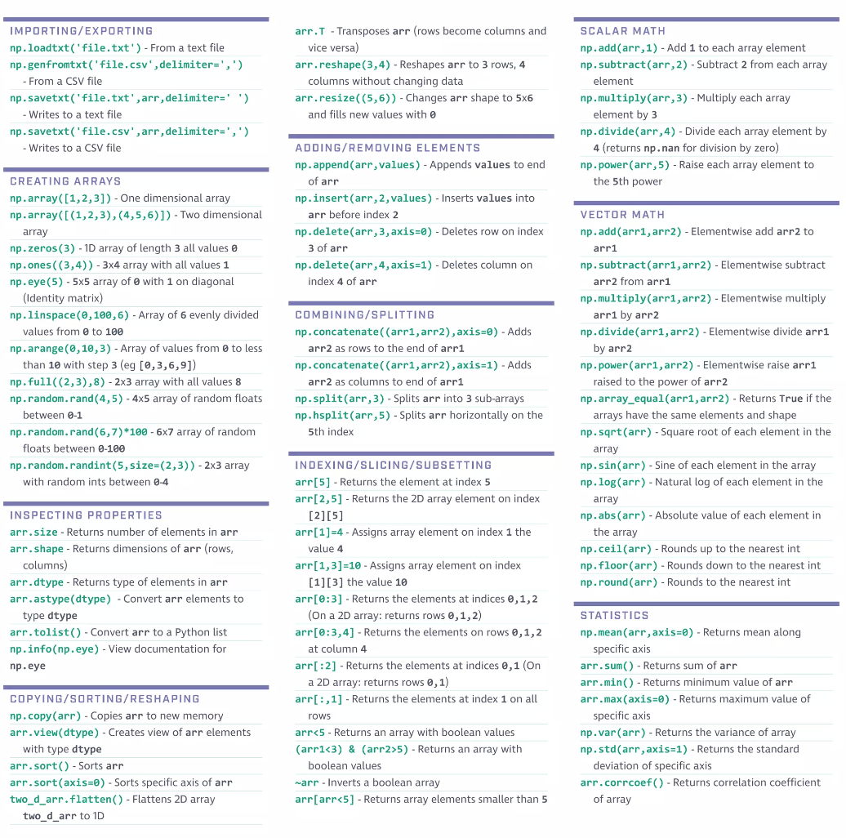
print
print
NumPy Cheat Sheet

